Slide 1


Slide 2

Latent TB
M. Marjani
NRITLD

Slide 3
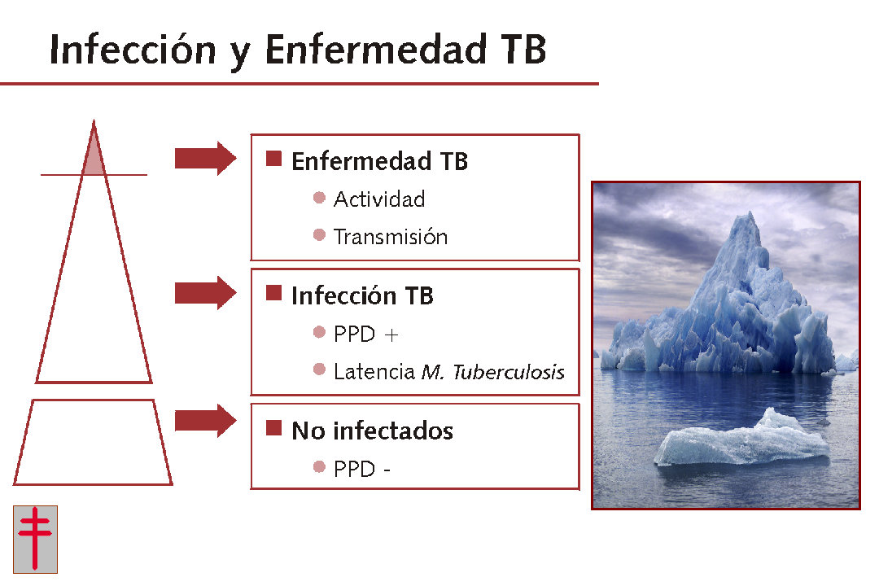
TB Infection and TB Disease
TB Disease
- Activity
- Transmission
TB Infection
- PPD Pos.
- Latent TB
Not infected
- PPD Neg.
World Population: 6700 Milions
Infected with M.TB: 2300 Milions
WithTB Disease: 8.8 Milions

Slide 4
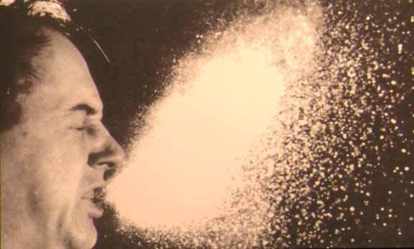

TB Transmission. Contagious aerosols (droplets < 5 microns)

Slide 5
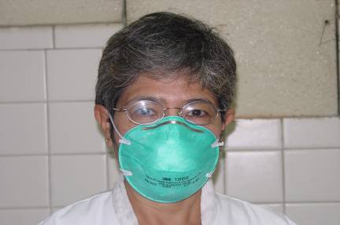
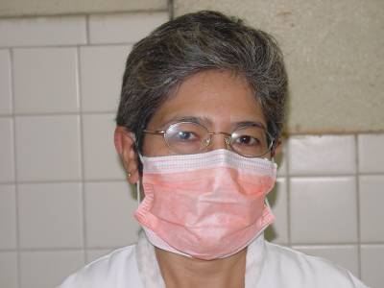

Personal protective equipment
Respirators vs. Masks

Slide 6
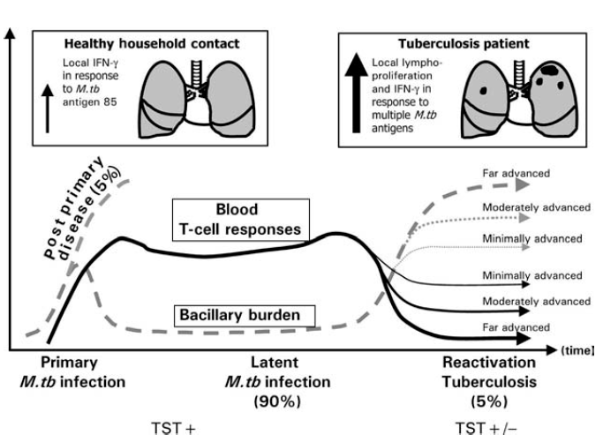
Hypothetical model of the natural history of Mycobacterium tuberculosis Infection

Slide 7
WHAT IS LTBI?

Slide 8
LTBI
LTBI is diagnosed when an individual:
  shows positive reaction to the TST/IGRA
    but
  does not have any clinical, bacteriological (if done), or radiographic evidence of active TB

Slide 9
DIAGNOSTIC CRITERIA
No symptoms to suggest active disease
Normal CXR (usually)
Negative sputum smear for AFB (if collected)
“Positive” TST (Mantoux Test)/IGRA

Slide 10
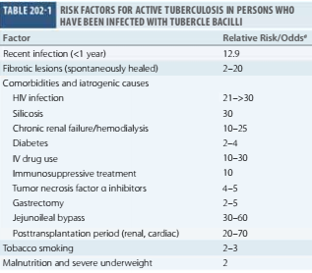

Slide 11
Diagnosis of LTBI
TST
IGRA
Dependent on the demonstration of host immune response toward tuberculous proteins.
Notes:
The diagnosis of LTBI could not rely on any these features.
Currently, the diagnosis of LTBI is still dependent on the demonstration of host immune response toward tuberculous proteins.

Slide 12
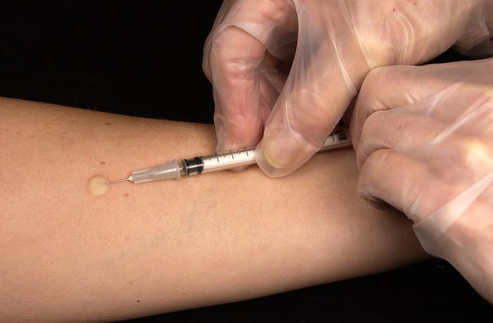

Slide 13
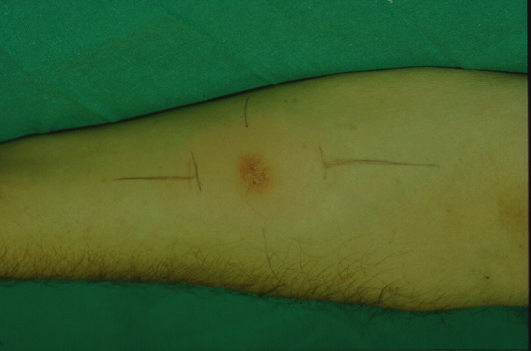

Diagnosis of TB disease
Tuberculin Test
- PPD (+) only helps in:
- Children < 5 Years
- Severe immunodeficiency
- PPD (-) only helps :
When considering TB in the
differential diagnosis

Slide 14
Factors That May Cause False-Negative
TST Reactions
Recent TB Infection
    Defined as less than 10 weeks after exposure
Overwhelming TB Disease
Immune deficiency
Very young age
    Newborns (< 6 months)
Live virus vaccination
Poor TST administration technique

Slide 15
THE SHORTCOMINGS OF TST
Tuberculin contains
>200 proteins, widely shared among the mycobacteria.
TB
NTM
BCG

Slide 16
Positive PPD
High risk group
Measured Induration | High Risk Group | Positive TST
> 5 mm | Recent Contact with TB case | Yes
 | HIV-positive person | Yes
 | Abn Chest x-ray (Nodular or Fibrotic Δ) | Yes
 | Organ Transplant Recipient | Yes
 | On Immunosuppressant Medication
 | > 15 mg/day Prednisone, for > 1 month | Yes
 | > 2 mg/kg/day of azathioprine | Yes
 | > 1 mg/kg/day of 6-mercaptopurine | Yes
 | > 25 mg/week of methotrexate | Yes
 | Any anti-TNF-α medication | yes

Slide 17
Moderate Risk Groups
Measured Induration | Moderate Risk Group | Positive TST
> 10 mm | Residents and employees of high-risk congregate settings (prisons, nursing homes, hospitals, homeless shelters) | yes
 | IV Drug Users | Yes
 | Mycobacteriology Laboratory personnel | Yes
 | Medical Conditions: silicosis, diabetes mellitus, chronic renal failure, significant weight loss > 10% of IBW, prior gastrectomy or jejunoileal bypass, and leukemia | Yes
 | Children < 4 yrs of age or children exposed to adults in high-risk category | Yes
 | Recent immigrants (<5 yrs) from high prevalence countries | yes
Harrisson: 5 mm

Slide 18
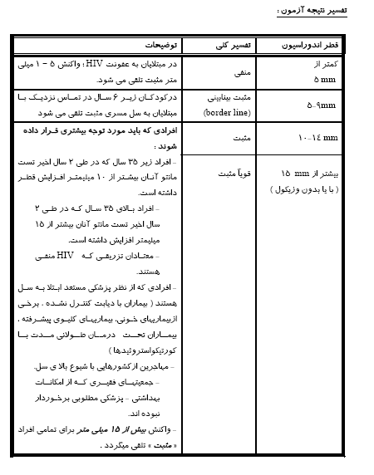

Slide 19
NEW TESTS - IGRA
Recently, with the invention of 2 new tests, collectively known as IGRA
  QuantiFERON-Gold-In-Tube (QFT-GIT) test
  Elispot test (T-SPOT)
    the prospect of differentiating LTBI from BCG vaccination/NTM infection has becoming promising.
Notes:
Recently, with the invention of 2 novel tests, the QuantiFERON-GOLD (QuantiFERON-G) test and Elispot tests, the prospect of differentiating LTBI from BCG vaccination/NTM infection has been promising.

Slide 20
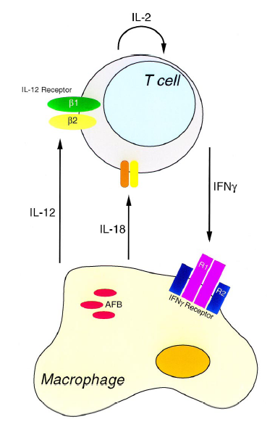

Slide 21
PRINCIPLE OF IGRA
2 to 3 specific antigens are utilized,
  ESAT-6 (early secretory antigenic target-6)
  CFP-10 (culture-filtrate protein-10)
  TB 7.7 (only in QFT test)
  expressed in M. tuberculosis complex,
  absent from all strains of BCG & majority of NTM
Notes:
In majority of NTM except M. szulgai, M. kansasii, M. marinum

Slide 22
PRINCIPLE OF IGRA
  Because ESAT-6 & CFP-10 is not shared by BCG & most NTM, T-cells of individuals with BCG vaccination or NTM infection alone, will not be stimulated to produce interferon-γ.
TB
NTM
BCG

Slide 23
CDC Guidance on Selection of TST or IGRA
Situations IGRA is preferred, but a TST is acceptable
  Testing persons with poor TST 48 hr return rates
  Previously BCG vaccine or cancer therapy
Situations TST is preferred, but IGRA is acceptable
  Children < 5 yrs (some experts require both TST & IGRA)
Situations where No Preference TST = IGRA
  Recent contacts of MTB
  MTB Screening & Surveillance Programs
Situations Both IGRA and TST may be considered
  When either test (-) and risk for MTB high and outcome poor
  IGRA indeterminate, TST may be helpful

Slide 24
IGRA
In summary, TST and IGRAs generally have comparable efficacy for diagnosis of LTBI in HCWs.
Previous studies have shown the superior cost-effectiveness of IGRAs over TST in low TB prevalence, high-income countries.
However, these findings needed to be confirmed by additional studies from high TB prevalence, resource limited settings.

Slide 25

WHAT IS THE ADVANTAGE OF TARGETED SCREENING?
Active TB
Latent TB
Notes:
Diagnosing active TB might not be easy. But the target is most of the time obvious.
Treating something hidden is much tougher, unless we apply a strategy what I call blanket bombings.

Slide 26
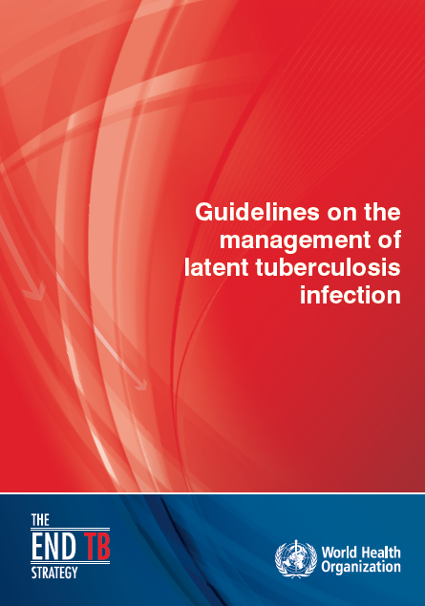
Guidelines on the management of latent tuberculosis infection WHO 2014
Notes:
The guidelines are primarily targeted at high-income or upper middle-income countries
with an estimated TB incidence rate of less than 100 per 100 000 population. Resource-limited and
other middle-income countries that do not belong to the above category should implement the
existing WHO guidelines on people living with HIV and child contacts below 5 years of age.

Slide 27
WHO 2018

Slide 28
Systematic testing and treatment of LTBI should be performed:
HIV
Close contacts
Transplantation
Under Dialysis
Silicosis
Anti TNF therapy
Guidelines on the management of latent tuberculosis infection WHO 2014
Notes:
It also emphasized the importance of further research on the benefits and harms of LTBI testing and treatment in persons with silica exposure, patients receiving steroid treatment, patients with rheumatologic conditions, indigenous populations and cancer patients.

Slide 29
Systematic testing and treatment of LTBI should be considered:
Prisoners
HCW
Homeless persons
Illicit drug users
Immigrants
Guidelines on the management of latent tuberculosis infection WHO 2014
Notes:
It was noted that the high risk of ongoing TB transmission in certain risk groups, such as health-care workers (including students), prisoners
(including prison staff), homeless and illicit drug users, require attention so that the benefit of treatment is not compromised through reinfection.

Slide 30
Systematic testing for LTBI is not recommended:
DM
Smokers
Alcoholics
Underweight
Guidelines on the management of latent tuberculosis infection WHO 2014
Notes:
The Panel noted the paucity of data on the benefits and harms of systematic latent TB testing and treatment in diabetic patients, people with harmful alcohol use, tobacco smokers and underweight people and concluded that the benefits of systematic and routine testing and treatment in these risk groups do not outweigh the risks unless individuals/patients also belong to the groups mentioned in the above recommendations.

Slide 31
Diagnosis of Active TB
Symptoms
Signs
CXR
Sputum AFB
PCR
Biopsy
Culture
Notes:
Compare to active TB, where diagnosis could be suspected or diagnosed based on various clues

Slide 32
اقدامات اوليه در رد سل فعال
در برخورد با فردي که با بيمار مسلول تماس نزديک داشته است، اولين اقدام رد سل فعال مي باشد.
لذا در صورت شک به سل فعال ابتدا بايد بيماري رد و سپس بررسي هاي مربوط به LTBI انجام شود. ضروري است دقت شود که تا سل فعال رد نشده درمان LTBI به هيچ عنوان شروع نشود.

Slide 33
رد سل فعال با گرفتن شرح حال و انجام معاينه باليني شروع مي شود. به اين منظور بايد علايم مرتبط با سل فعال از افراد در معرض تماس سوال گردد و چنانچه فرد علامتدار است جهت تشخيص يا رد بيماري بر اساس دستورالعمل کشوري بيماري سل اقدام گردد.
تاکيد بر علايم اصلي بيماري سل ريوي شامل سرفه، خلط (خصوصا خلط خوني)، تب، کاهش وزن، تعريق شبانه، تنگي نفس، درد قفسه سينه و خستگي مفرط و همچنين توجه به علايم سل خارج ريوي ضروري است.

Slide 34
ANTITB REGIMENS FOR LTBI
Drugs | Duration | Interval | Completion criteria
Isoniazid | 6 - 9 months | Daily | 180 doses in 9 months (6-month regimen) 270 doses in 12 months (9-month regimen)
Isoniazid + rifampicin | 4 months | Daily | 120 doses within 6 months
Rifampicin | 4 months | Daily | 120 doses within 6 months
Isoniazid & rifapentine* | 3 months | Once weekly | 12 doses

Slide 35
درمان پیشنهادی در ایران
رژيم مورد استفاده | دوز بر اساس وزن | حداکثر دوز
ايزونيازيد روزانه به تنهايي به مدت شش تا نه ماه | Adults = 5 mg/kg Children = 10 mg/kg | 300 mg
ايزونيازيد و ريفاپنتين هفتگي به مدت سه ماه (12 دوز) | Adults and Children Isoniazid: 15 mg/kg Rifapentine (by body weight): 10 - 14 kg = 300 mg 14.1 - 25 kg = 450 mg 25.1 - 32 kg = 600 mg 32.1 -49.9 kg = 750 mg | Isoniazid = 900 mg Rifapentine = 900 mg

Slide 36
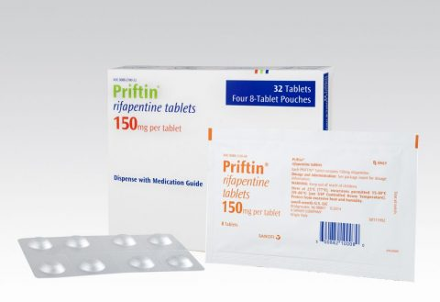


Slide 37

Counseling a Patient with LTBI (cont.)
Good news:
“You do not have
the disease and you
are not contagious
to anyone.”
Bad news:
“However, it is sleeping in your body and if you don’t treat it now it can wake up later and make you very ill and contagious to others.”
Notes:
Supplement: “I’m worried about those days 20 years from now when you don’t have the health reserve you have now and you might have chronic medical problems I have to deal with that put you at even higher risk for disease; I want to take care of this now.”

Slide 38
Management of latent TB among HCW
M Marjani

Slide 39
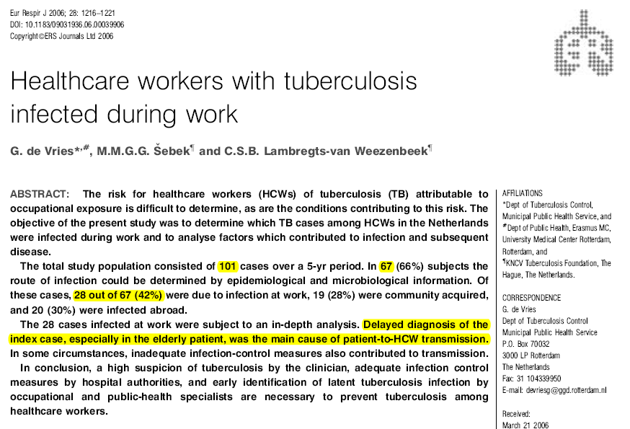

Slide 40
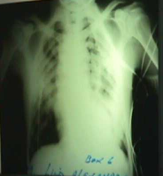
Periodic screening of health workers to detect disease at an early stage
Each year for employees
Medical questionnaire
Chest x-ray, Mantoux test
Sputum exam if cough > 3 weeks
Special consideration for employees with increased individual risk
Notes:
Periodic screening of health workers and prisoners should be conducted to detect disease at an early stage.
This screening should be conducted each year for employees and twice yearly for prisoners.
Health workers can be screened by a medical questionnaire as well as a chest radiograph if findings are suggestive of previous TB, or a sputum exam if cough > 3 weeks.
Finally, special consideration should be given to employees or prisoners with increased individual risk.

Slide 41





Guidelines for Preventing the Transmission of M. tuberculosis in Health-Care Settings, 2005
Division of Tuberculosis Elimination

Slide 42
HCWs Who May Be Included in a
TB Testing Program
Paid and unpaid persons working in health-care settings who have potential for exposure to M. tuberculosis through shared air space with infectious patient.
Includes part-time, full-time, temporary, and contract staff.
All HCWs whose duties involve face-to-face contact with suspected or confirmed TB should be in a TB screening program

Slide 43
Risk for Health-care–Associated Transmission of M. tuberculosis (2)
Linked to close contact with infectious TB patients during procedures generating aerosols:
Bronchoscopy
Endotracheal intubation or suctioning
Open abscess irrigation
Autopsy
Sputum induction
Aerosol treatments

Slide 44
TB Risk Classifications
Low risk : exposure unlikely.
Medium risk – HCWs will or might be exposed to persons with TB disease.
Potential ongoing transmission.
  Temporary classification for any settings with evidence of person-to-person transmission of M. tuberculosis

Slide 45
TB Risk Classifications
Inpatient Settings | Low | Medium | Potential Ongoing Transmission
<200 beds | <3 TB patients/yr | >3 TB patients/yr | Evidence of ongoing transmission, regardless of setting
≥200 beds | <6 TB patients/yr | >6 TB patients/yr

Slide 46
TB Risk Classifications
Outpatient Settings | Low | Medium | Potential Ongoing Transmission
TB treatment facilities, medical offices, ambulatory care settings | <3 TB patients/yr | >3 TB patients/yr | Evidence of ongoing transmission, regardless of setting

Slide 47
TB Risk Classifications
Nontraditional Facility-based Settings | Low | Medium | Potential Ongoing Transmission
Emergency medical service (EMS), medical settings in correctional facilities, outreach care, long-term care facilities | Only patients with LTBI treated No cough-inducing procedures are performed in setting System to detect/triage persons with TB symptoms | Settings where TB patients are expected to be encountered | Evidence of ongoing transmission regardless of setting

Slide 48
TB Testing Frequency
Risk classification | Frequency
Low | Baseline on hire; further testing not needed unless exposure occurs
Medium | Baseline, then annually
Potential ongoing transmission | Baseline, then every 8–10 wks until evidence of transmission has ceased

Slide 49
TB Testing Frequency for HCWs Who Transfer
Situation | Risk Classification Change
 | Low→Low | Low→Med | Low or Med → Potential Ongoing Transmission
Baseline | Yes | Yes | Yes
Routine testing | No | Every 12 months | As needed in investigation
After exposure | Yes, and if TST negative, 8–10 wks after last potential exposure to M. tuberculosis

Slide 50
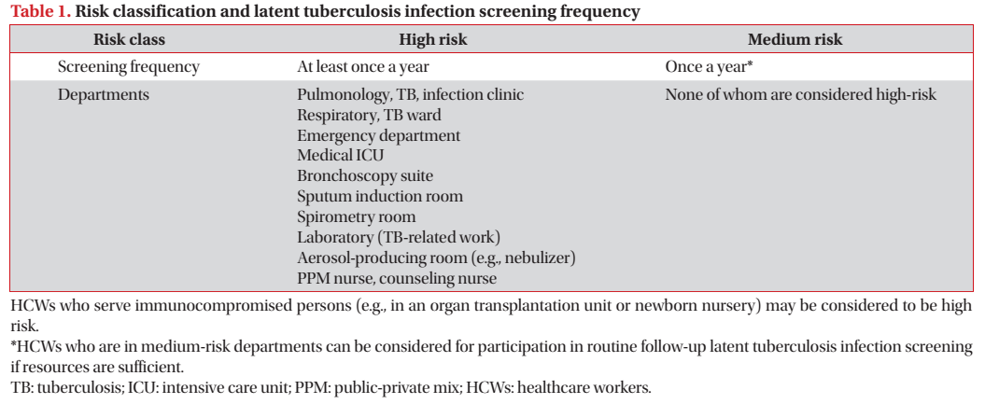
Tuberc Respir Dis 2016;79:127-133

Slide 51
TB Infection Control Surveillance
TB screening programs provide critical info and consist of
Baseline testing for M. tuberculosis infection (new hires)*
Serial testing for M. tuberculosis infection
Serial screening for symptoms or signs
  Clinical evaluation
  Chest radiograph
TB training and education
* And other persons who will be tested periodically (i.e., residents and staff of long term–care facilities and correctional settings).

Slide 52
Interpreting TST for HCWs
1. Baseline | ≥10 mm = positive (≥5 if HCW has HIV)
2. Serial testing | Increase of ≥10 mm = positive (TST conversion)
3. Known exposure (contact investigation) | ≥5 mm = positive when baseline result is 0 mm; increase of ≥10 mm = positive when baseline or previous follow-up TST result is >0mm, but <10mm

Slide 53
TST Boosting
Some with LTBI have a negative TST reaction when tested years after infection.
Initial TST may stimulate (boost) ability to react.
Positive reactions to subsequent TSTs could be misinterpreted as indicating recent infection.

Slide 54
TST Two-Step Testing
Used for initial baseline M. tuberculosis testing for those who will be given TST periodically
No previous TST: do two-step test
First test positive: consider TB infected
First test negative: retest in 1–3 wks (after first TST result was read)
Second test positive: consider TB infected
Second test negative: consider not infected

Slide 55
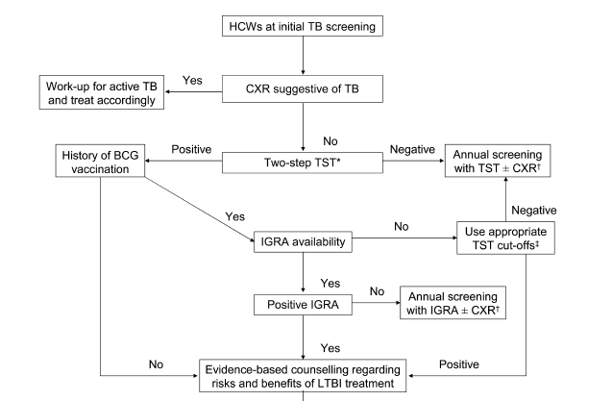

Slide 56
Unresolved issues
Continuous contact: ?
Other Contacts in the future: ?
Baseline positive PPD: ?
Repeat PPD after 8-12 w for close contacts

